Slide 1

Microsoft Excel Functions & Shortcuts for Beginners
Notes:
Determine the role of your spreadsheet, P&L , budget, what-if , tables, graphics?
Adopt a standard and stick to it-Department should have a certain standard such as naming criteria, formatting & location
Work as a team in creating spreadsheets used by a group
Identify the audience-TOO much information (that’s me)
Include an “about” sheet to document the spreadsheet
Design for Longevity
Be consistent in formulas and structure

Slide 2
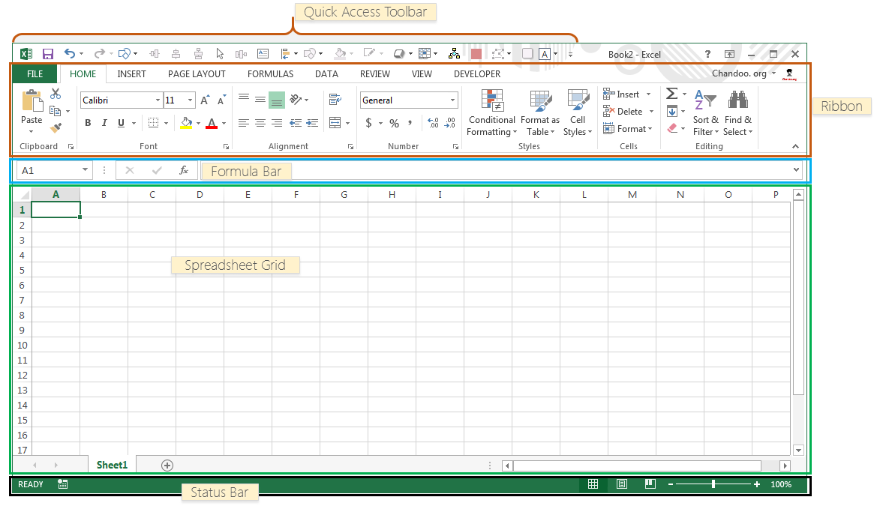
Notes:
There are 5 important areas in the screen.
1. Quick Access Toolbar: This is a place where all the important tools can be placed. When you start Excel for the very first time, it has only 3 icons (Save, Undo, Redo). But you can add any feature of Excel to to Quick Access Toolbar so that you can easily access it from anywhere (hence the name).
2. Ribbon: Ribbon is like an expanded menu. It depicts all the features of Excel in easy to understand form. Since Excel has 1000s of features, they are grouped in to several ribbons. The most important ribbons are – Home, Insert, Formulas, Page Layout & Data.
3. Formula Bar: This is where any calculations or formulas you write will appear. You will understand the relevance of it once you start building formulas.
4. Spreadsheet Grid: This is where all your numbers, data, charts & drawings will go. Each Excel file can contain several sheets. But the spreadsheet grid shows few rows & columns of active spreadsheet. To see more rows or columns you can use the scroll bars to the left or at bottom. If you want to access other sheets, just click on the sheet name (or use the shortcut CTRL+Page Up or CTRL+Page Down).
5. Status bar: This tells us what is going on with Excel at any time. You can tell if Excel is busy calculating a formula, creating a pivot report or recording a macro by just looking at the status bar. The status bar also shows quick summaries of selected cells (count, sum, average, minimum or maximum values). You can change this by right clicking on it and choosing which summaries to show.

Slide 3
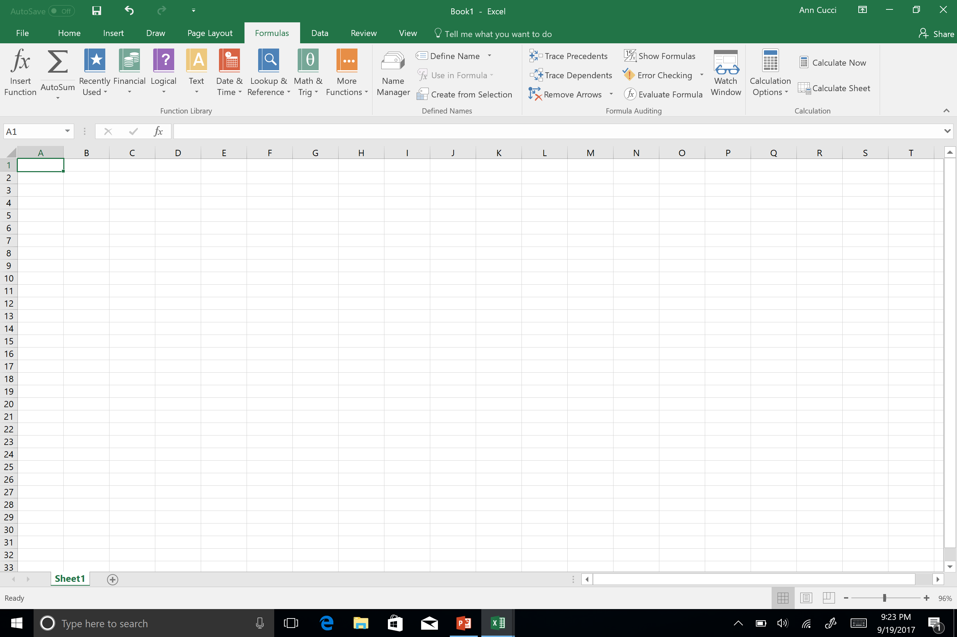

Slide 4
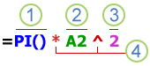
Parts of a Formula
Functions
References
Constants
Operators
Notes:
When we speak about functions, they are actually part of a formula
1Functions: included with Excel, functions are engineered formulas that carry out specific calculations. For example, the PI() function returns the value of pi: 3.142...
2References: refer to individual cells or ranges of cells. A2 returns the value in cell A2.
3Constants: numbers or text values entered directly into a formula, such as 2.
4 Operators: The ^ (caret) operator raises a number to a power, and the * (asterisk) operator multiplies. Use + and – add and subtract values, and / to divide.

Slide 5
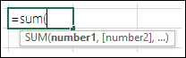
Formula Example ~ Single Argument
=SUM(A1:A10) is an example of a single argument.

Slide 6
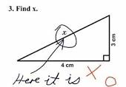
Mathematical Formulas
Sum
Count
Counta
Sumif
Average
Round
Product
Roman
Notes:
Sum adds a group of numbers
Count Counts the number of cells in a range, but only numbers
Counta Counts the nonempty cells
Product Multiplies a bunch of numbers

Slide 7
SUMIF

Slide 8
SUMIF
We want to know how many HP Laser Jet Printers we have.
=sumif(a2:a14,”HP Laser Jet”,c2:c14)
Which equals 11
We want to know how many HP Laser Jet Printers the POLICE have.
=sumifs(c2:c14,a2:14,”HP Laser Jet”,b2:b14,”Police”)
Which equals 3

Slide 9
SUMIF

Slide 10
AVERAGE

Slide 11
ROUND

Slide 12
Using Rounding for Budgeting

Slide 13
ROMAN/ARABIC

Slide 14
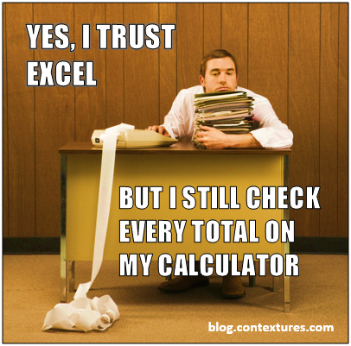
Logical Formulas
If
And
Or
Not
Choose
Iferror
Istext
Notes:
And – checks whether conditions are met or not (TRUE or FALSE) or can be used in a function
Or – similar but checks if any conditions are met

Slide 15
IF

Slide 16
IFERROR

Slide 17
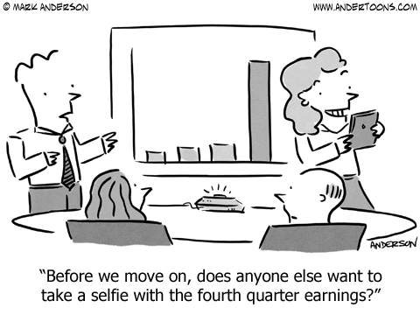
Text Formulas
Proper
Trim
Dollar
Rept
Text
Type
Notes:
Proper – converts text to the proper state where something is all caps or mixed caps and lower case
Trim – removes unnecessary spaces in a given text
Dollar – Converts a number to $ currency format (can use with a total formula)
REPT – repeats a particular text a specific number of times (great for illustrating a graph like number of occurrences graphically with lines)
Text – can convert something in text into a number, date or time formula

Slide 18

Shortcuts
Keyboard Shortcuts
Insert Function
Define Name
Error Checking
Watch Window
Notes:
Define a range name such as data to quickly reference an area in the spreadsheet

Slide 19

Keyboard Shortcuts
F2
Ctrl-Home
Double Click to change a tab/sheet name
Copy sheet within a workbook
Right Click to get Menu
Press “Alt” Key and letters appear called “Key Tips”
Notes:
F2 – If a formula’s source cells are on the same page, the F2 shortcut puts the cell into edit mode so you can visually see where the data is coming from
CTRL HOME
Double Click to change a tab/sheet name
Copy sheet within a workbook
Right click to get menu
Press “ALT” key and letters appear called KEY TIPS

Slide 20
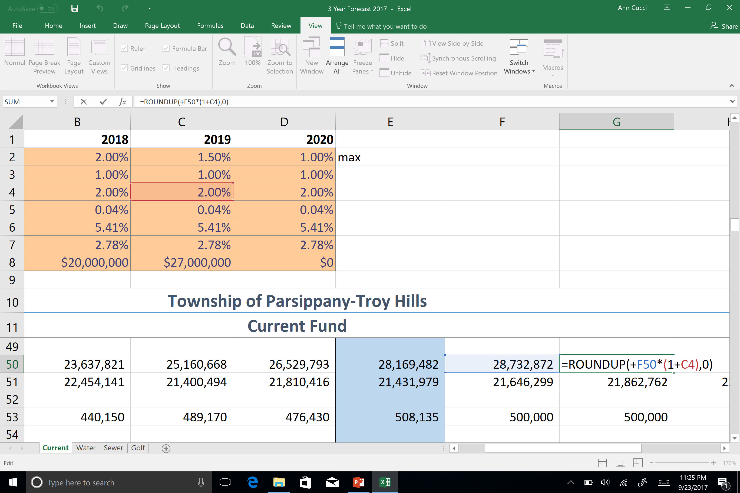
F2
Notes:
In G50

Slide 21
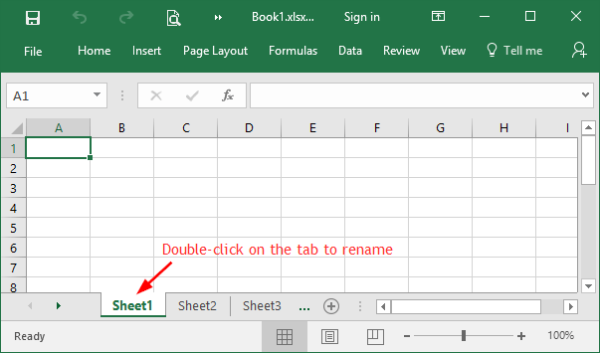
Double Click to Change a Tab Name

Slide 22
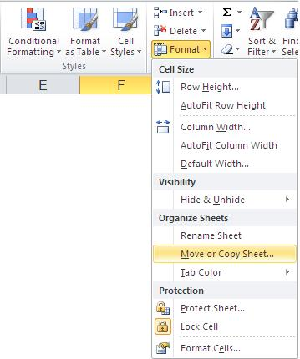
Copy a Sheet ~ Copies WITH Format
Notes:
Copying using Format Function on Home Ribbon or
“Right” click on the tab

Slide 23
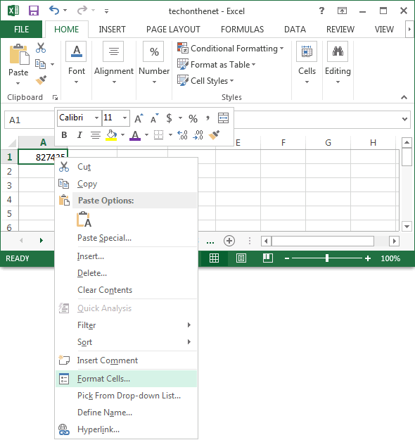
Right Click Menu

Slide 24
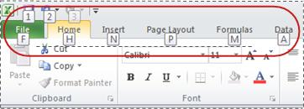
ALT Key to see “Key Tips”

Slide 25
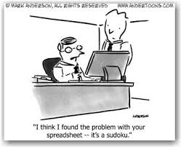
Error Messages

Slide 26
Error Types
Error Type When It Happens
#DIV/0! When you divide by ZERO
#N/A! When a formula or a function inside a formula cannot find the referenced data.
#NAME? When the text in a formula is not recognized.
#NULL! When a space was used instead of a comma in formulas that reference multiple ranges. A comma is necessary to separate range references.

Slide 27
Error Types
Error Type When It Happens
#NUM! When a formula has numeric data
#REF! When a reference is invalid.
#VALUE! When the wrong type of operand or function argument is used

Slide 28
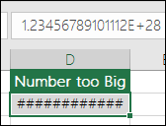
###########
Notes:
Description
Excel displays this error when a column is not wide enough to display all the characters in a cell, or a cell contains negative date or time values.
For example, a formula that subtracts a date in the future from a date in the past, such as =06/15/2008-07/01/2008, results in a negative date value.
TIP: Try to auto-fit the cell by double-clicking between the column headers. If ### is displayed because Excel can’t display all of the characters this will correct it.

Slide 29
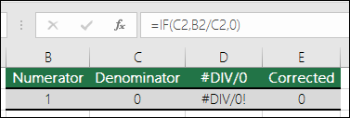
#DIV/0!
Notes:
Excel displays this error when a number is divided either by zero (0) or by a cell that contains no value.
TIP: Add an error handler like in the following example, which is =IF(C2,B2/C2,0)

Slide 30
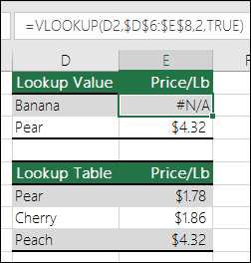
#N/A!
Excel displays this error when a value is not available to a function or formula.
=IFERROR(VLOOKUP(D2,$D$6:$E$8,2,TRUE),0)
Notes:
Excel displays this error when a value is not available to a function or formula.
If you’re using a function like VLOOKUP, does what you’re trying to lookup have a match in the lookup range? Most often it doesn’t.
Try using IFERROR to suppress the #N/A. In this case you could use:
=IFERROR(VLOOKUP(D2,$D$6:$E$8,2,TRUE),0)

Slide 31
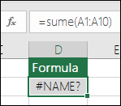
#NAME?
Notes:
This error is displayed when Excel does not recognize text in a formula. For example, a range name or the name of a function may be spelled incorrectly.
NOTE: If you’re using a function, make sure the function name is spelled correctly. In this case SUM is spelled incorrectly. Remove the “e” and Excel will correct it.

Slide 32
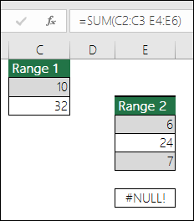
#NULL
=SUM(C2:C3 E4:E6)
Notes:
Excel displays this error when you specify an intersection of two areas that do not intersect (cross). The intersection operator is a space character that separates references in a formula.
NOTE: Make sure your ranges are correctly separated - the areas C2:C3 and E4:E6 do not intersect, so entering the formula =SUM(C2:C3 E4:E6) returns the #NULL! error. Putting a comma between the C and E ranges will correct it =SUM(C2:C3,E4:E6)

Slide 33
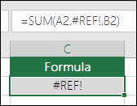
#REF!
This can happen when you delete a row or column in error.
You can “undo” using Ctrl+Z or the undo on the formula bar.
OR fix the formula to be “continuous” =SUM(A2:C2)
Notes:
Excel displays this error when a cell reference is not valid. For example, you may have deleted cells that were referred to by other formulas, or you may have pasted cells that you moved on top of cells that were referred to by other formulas.
Did you accidentally delete a row or column? We deleted column B in this formula, =SUM(A2,B2,C2), and look what happened.
Either use Undo (Ctrl+Z) to undo the deletion, rebuild the formula, or use a continuous range reference like this: =SUM(A2:C2), which would have automatically updated when column B was deleted.

Slide 34
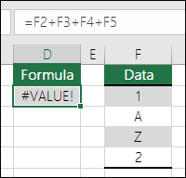
#VALUE!
This is displayed when a cell contains different types of data.
One way to fix this is to use =SUM(F2:F5)
Notes:
Excel can display this error if your formula includes cells that contain different data types.
Are you using Math operators (+, -, *, /, ^) with different data types? If so, try using a function instead. In this case =SUM(F2:F5) would correct the problem.

Slide 35
Absolute and Relative Referencing
Absolute cell reference contains a ($) in a Row and/or Column
Do not change when copied or filled
Use when you want to consistently refer to a certain cell
A1 Relative
A$1 Column is relative; Row is Constant
$A1 Row is relative; Column is absolute
$A$1 BOTH are Absolute
Notes:
An absolute cell reference is a cell address that contains a dollar sign ($) in the row or column coordinate, or both. When you enter a cell reference in a formula, Excel assumes it is a relative referenceunless you change it to an absolute reference.
Absolute and Relative Referencing Reference Type Formula What Happens After Copying the Formula RELATIVE: =A1 Either or both, column A and row #1 can change ABSOLUTE: =$A$1 The column letter A and row number 1 DO NOT CHANGE MIXED: =$A1 The column letter A does NOT change; Row number 1 CAN change. MIXED: =A$1 The column letter A CAN change; Row number 1 does NOT change. For Example:

Slide 36
Order of Operations
The Order of Operations tells Excel which operation to calculate first.
Parenthesis
Exponents
Multiplication & Division
Addition & Subtraction
Notes:
The order of operations will allow you to solve this problem the right way. The order is this: Parenthesis, Exponents, Multiplication and Division, Addition and Subtraction. Always perform the operations inside a parenthesis first, then do exponents.
A simple formula is a mathematical expression with one operator, such as 7+9. A complex formula has more than one mathematical operator, such as 5+2*8. When there is more than one operation in a formula, the order of operations tells Excel which operation to calculate first.

Slide 37
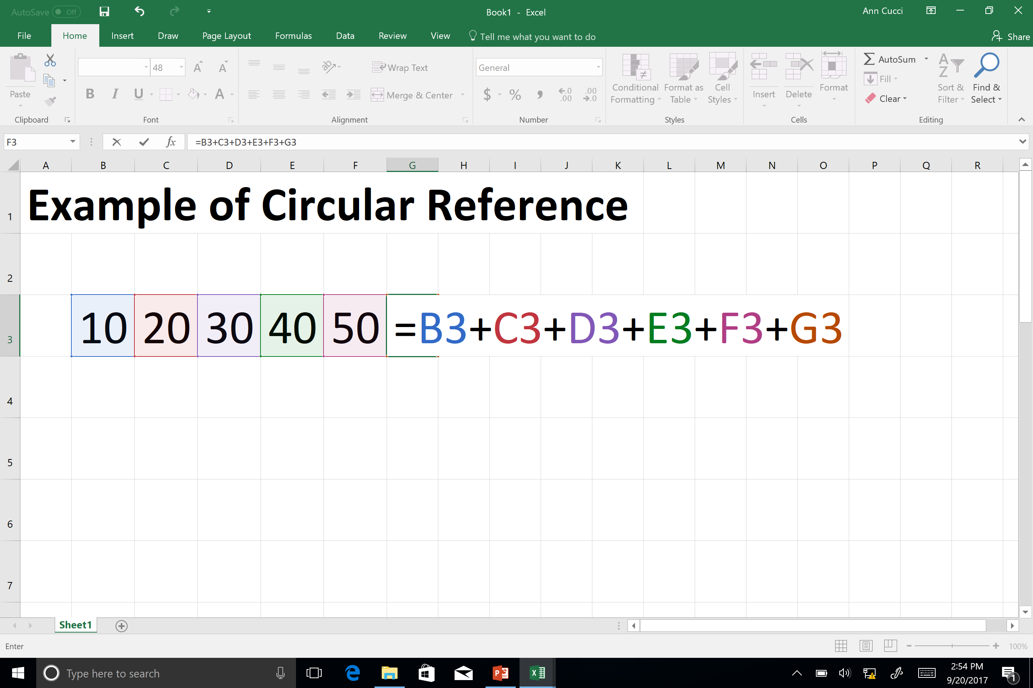
Circular Reference
A circular reference occurs when a cell refers to itself.

Slide 38
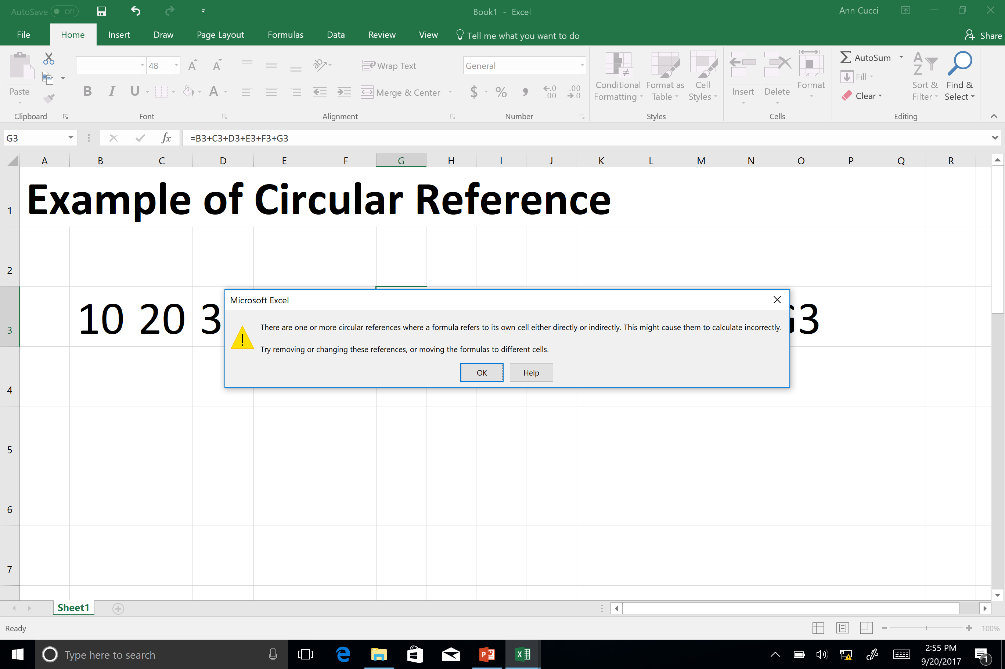

Slide 39
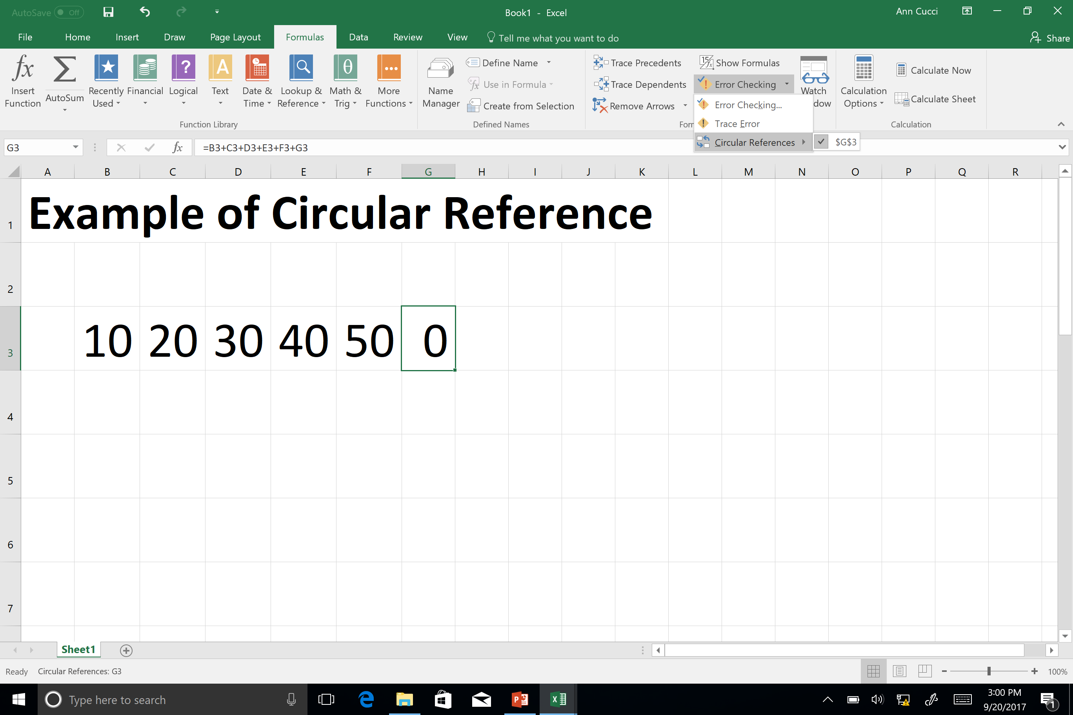
Notes:
Formulas Ribbon, Error Checking it will tell you at the bottom where the error is.

Slide 40
Common Formula Errors
Start with an “EQUAL SIGN” =
If you omit the equal sign, Excel thinks the data is “TEXT”
Match all open and closing parentheses
This gets more complicated as you add more formulas
=IF(B5<0),”Not Valid”,B5*1.05) – EXTRA Parentheses after <0
Use a colon to indicate a range
=SUM(A1:A5) not =SUM(A1 A5) returns #NULL

Slide 41
Common Formula Errors
Enter all required and correct type of arguments
Ex. Cannot combine SUM & REPLACE (Numerical vs Text)
Enter numbers without formatting
Ex. If you enter 1,000 into a formula vs 1000, it treats it like a comma separator looking at it like “1,000” or 1
CUT vs COPY
Relative vs Absolute

Slide 42
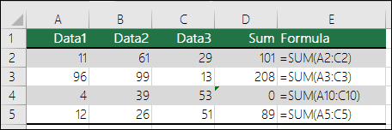
Formulas inconsistent with other formulas

Slide 43
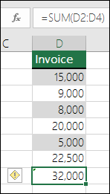
Formulas that omit cells in a group
Notes:
When Excel thinks there is a mistake
Returns an error message like “inconsistent formula”
Then Options such as copy the formula from the left
Get Help on the error
Ignore Error
Edit in Formula Bar (at top)

Slide 44
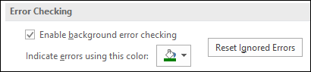
Error Checking ~ Reset Ignored Errors

Slide 45
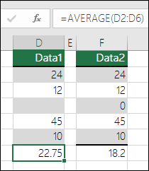
Formulas Referring To Empty Cells

Slide 46
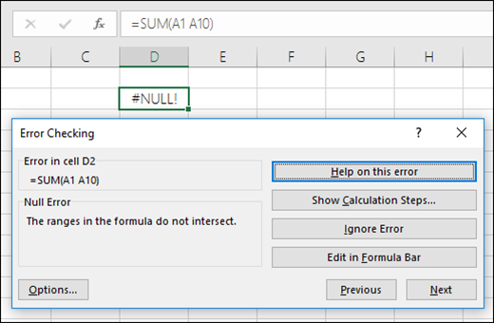
Error checking
Notes:
Ribbon > Formulas > Formula Auditing > Error Checking

Slide 47
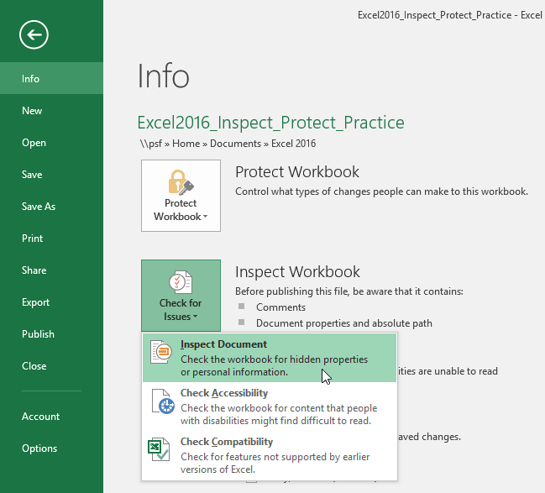
Ways to AUDIT your Spreadsheet
Inspect Workbook
F2
Notes:
Another way is to “Sort” to see extremes
Use an About or Welcome Sheet

Slide 48
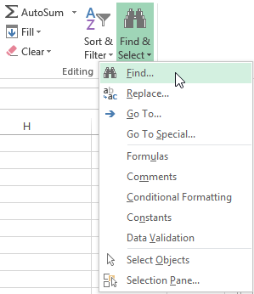
Find & Select
Find & Select is found on the Home Tab
Find and replace
Find Formulas, Comments, etc

Slide 49
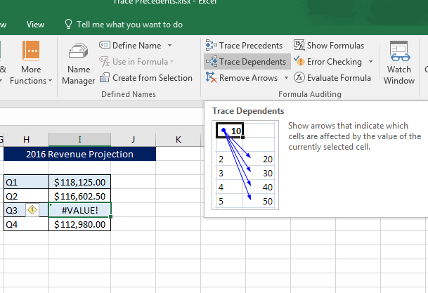
Trace Precedents/Dependents
Notes:
Dependent Traces formula to the dependent cell. Points to the cells that are dependent on the active cell
Precedent traces cells provide data to a formula

Slide 50

Watch Window
Used when cells and their formulas are not visible on a worksheet.
On large spreadsheets, you don’t have to repeatedly go to different parts of you spreadsheet to confirm formula calculations.
Notes:
When cells are not visible on a worksheet, you can watch those cells and their formulas in the Watch Window toolbar. The Watch Window makes it convenient to inspect, audit, or confirm formula calculations and results in large worksheets. By using the Watch Window, you don't need to repeatedly scroll or go to different parts of your worksheet.
This toolbar can be moved or docked like any other toolbar. For example, you can dock it on the bottom of the window. The toolbar keeps track of the following cell properties: 1) Workbook, 2) Sheet, 3) Name (if the cell has a corresponding Named Range), 4) Cell address, 5) Value, and 6) Formula.

Slide 51
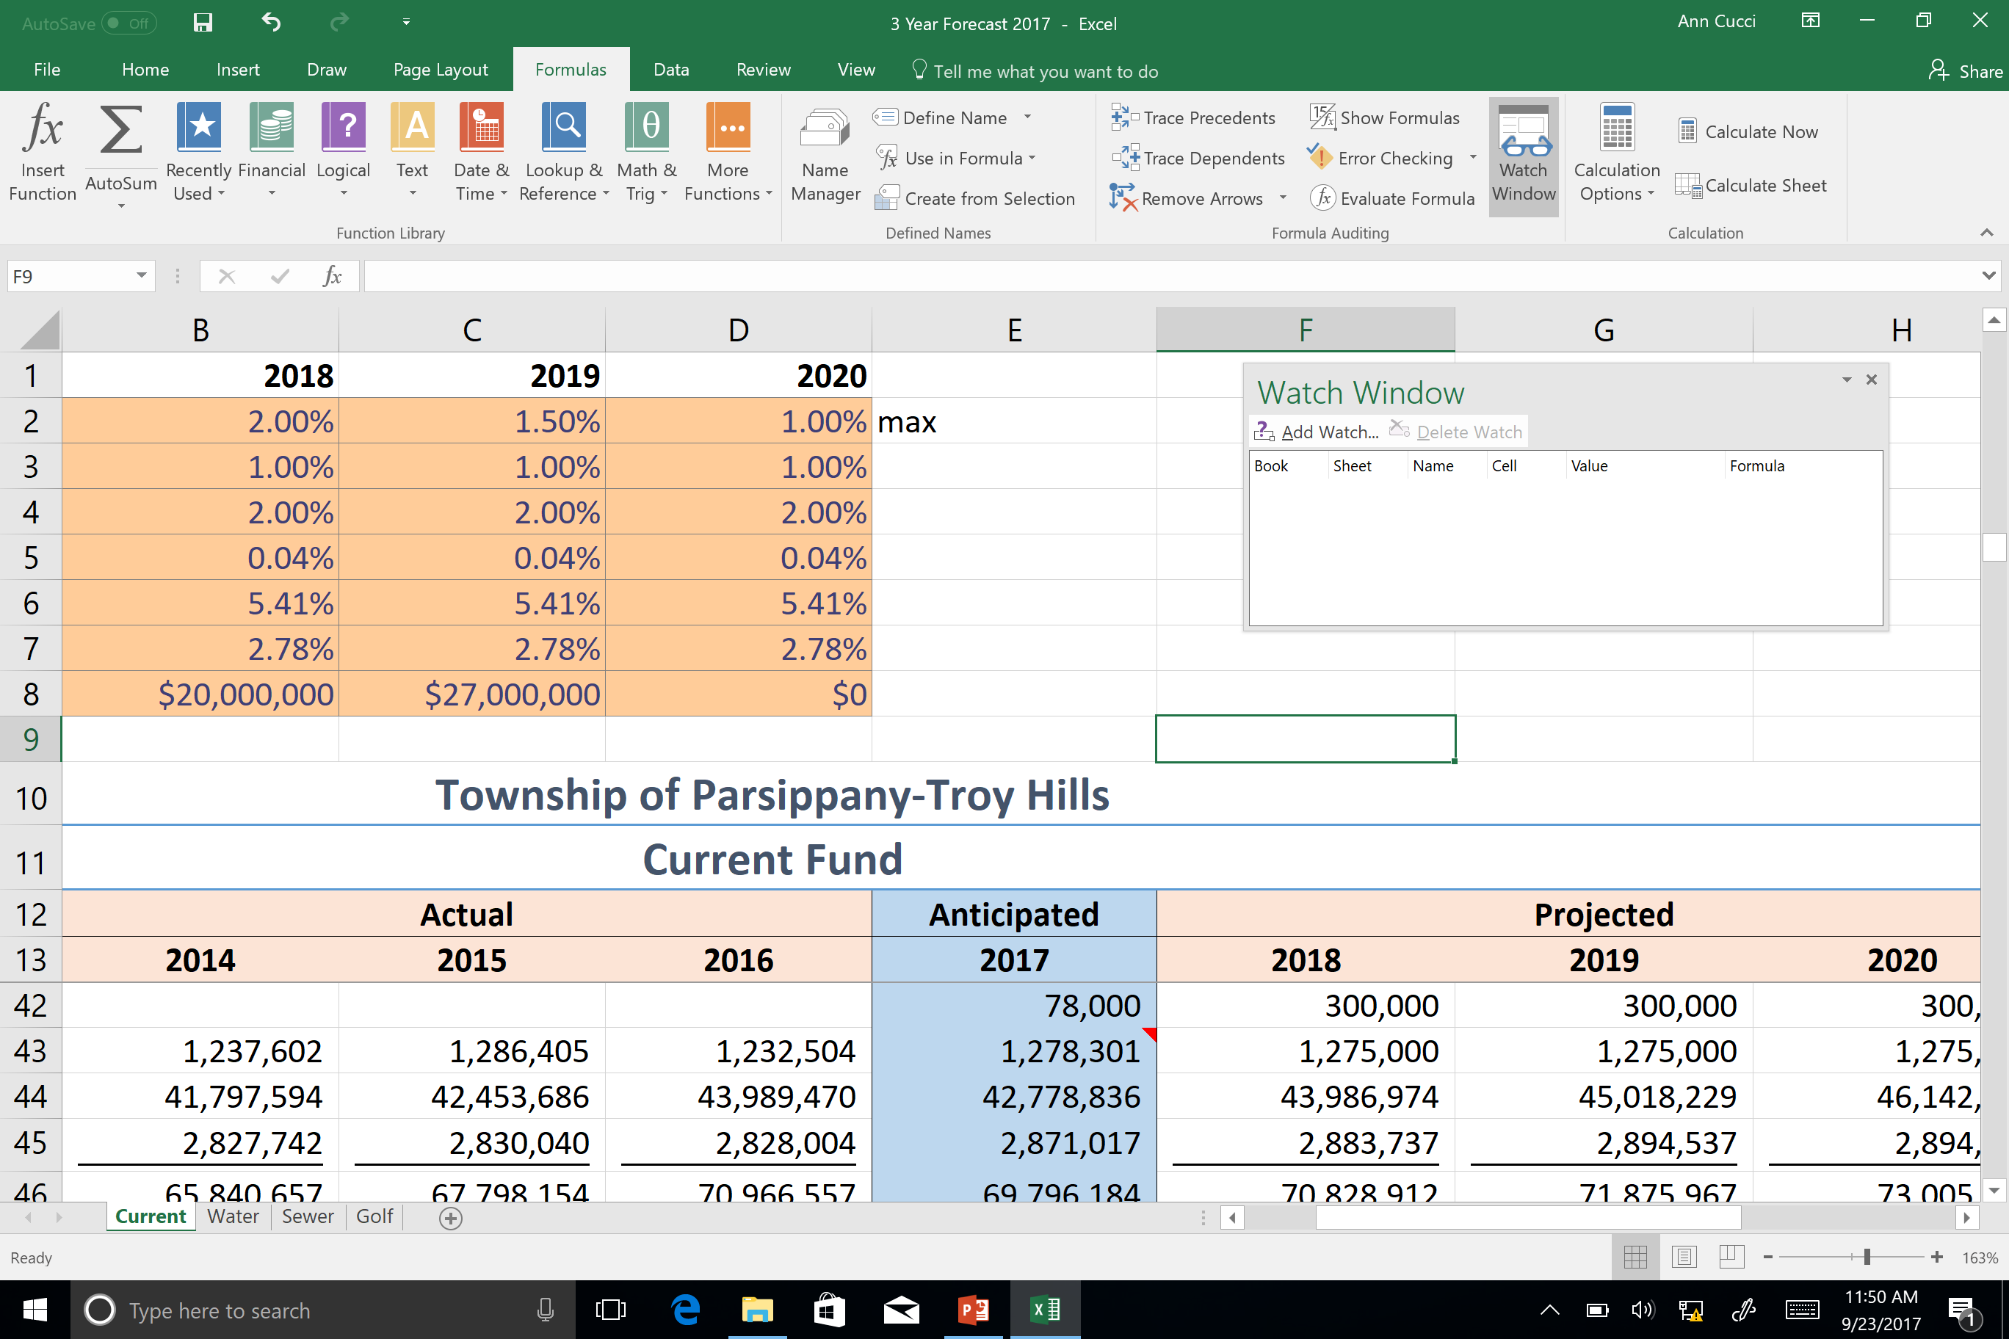
Add cells to the Watch Window
Notes:
Select the cells that you want to watch.
To select all cells on a worksheet with formulas, on the Home tab, in the Editing group, click Find & Select (or you can use Ctrl+G, or Control+G on the Mac)> Go To Special > Formulas.
On the Formulas tab, in the Formula Auditing group, click Watch Window.
Confirm that you have selected all of the cells you want to watch and click Add.

Slide 52
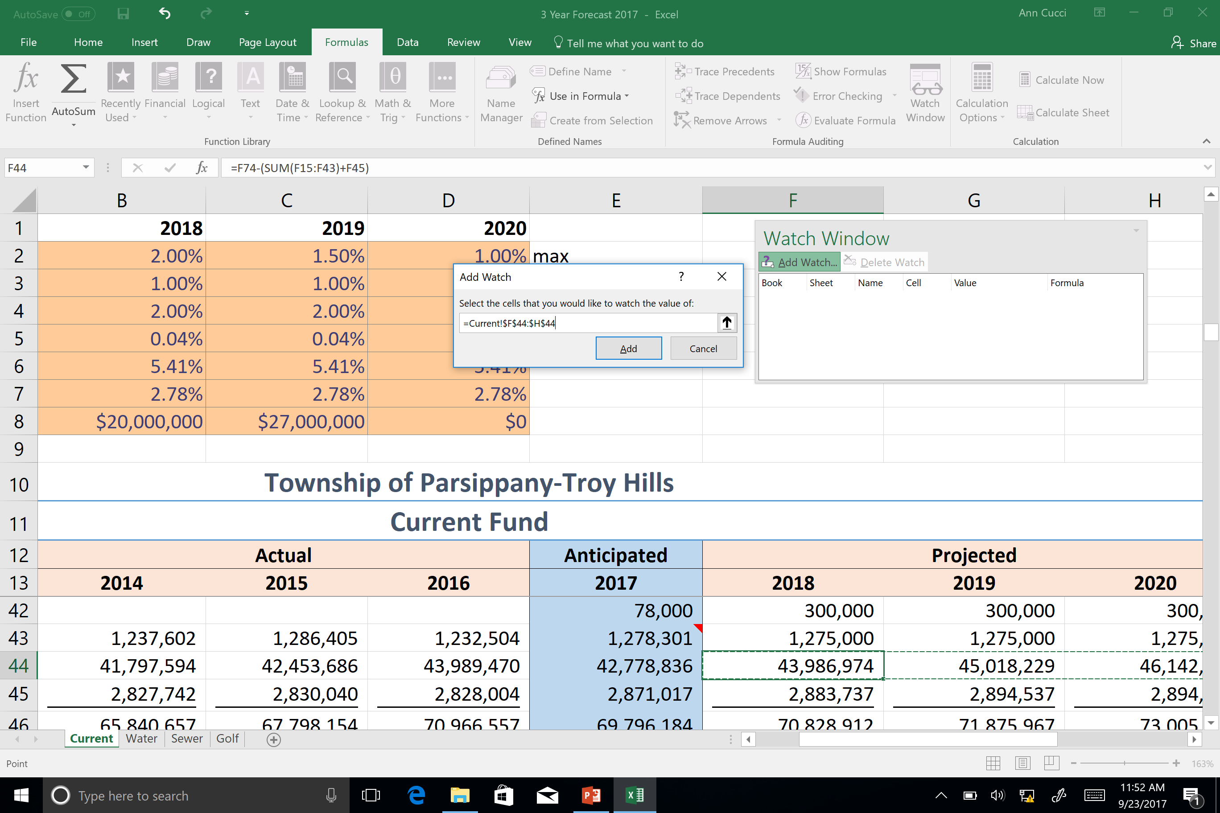
Specify What You Want to “Watch”
Notes:
Amount to be raised by taxes

Slide 53
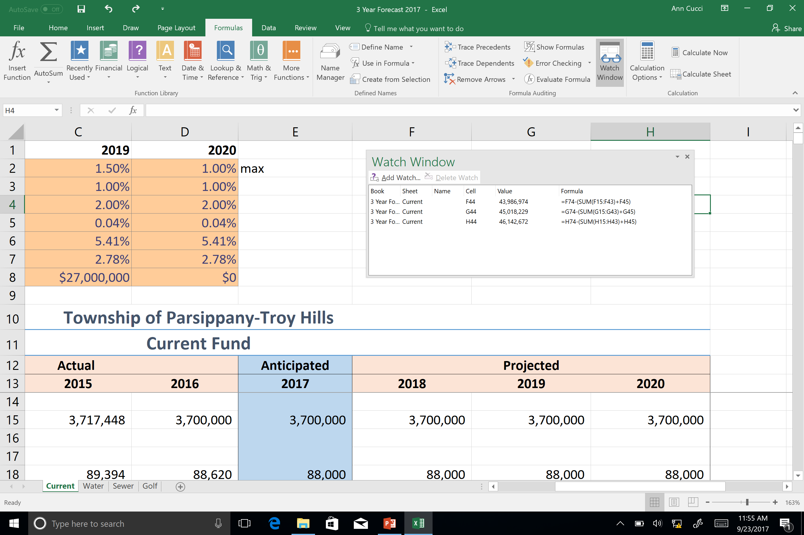
Now I can see how changes effect amount to be raised no matter where I go in the sheet

Slide 54
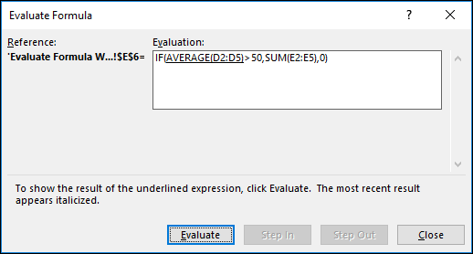
Evaluate Formula
Notes:
Formula auditing

Slide 55
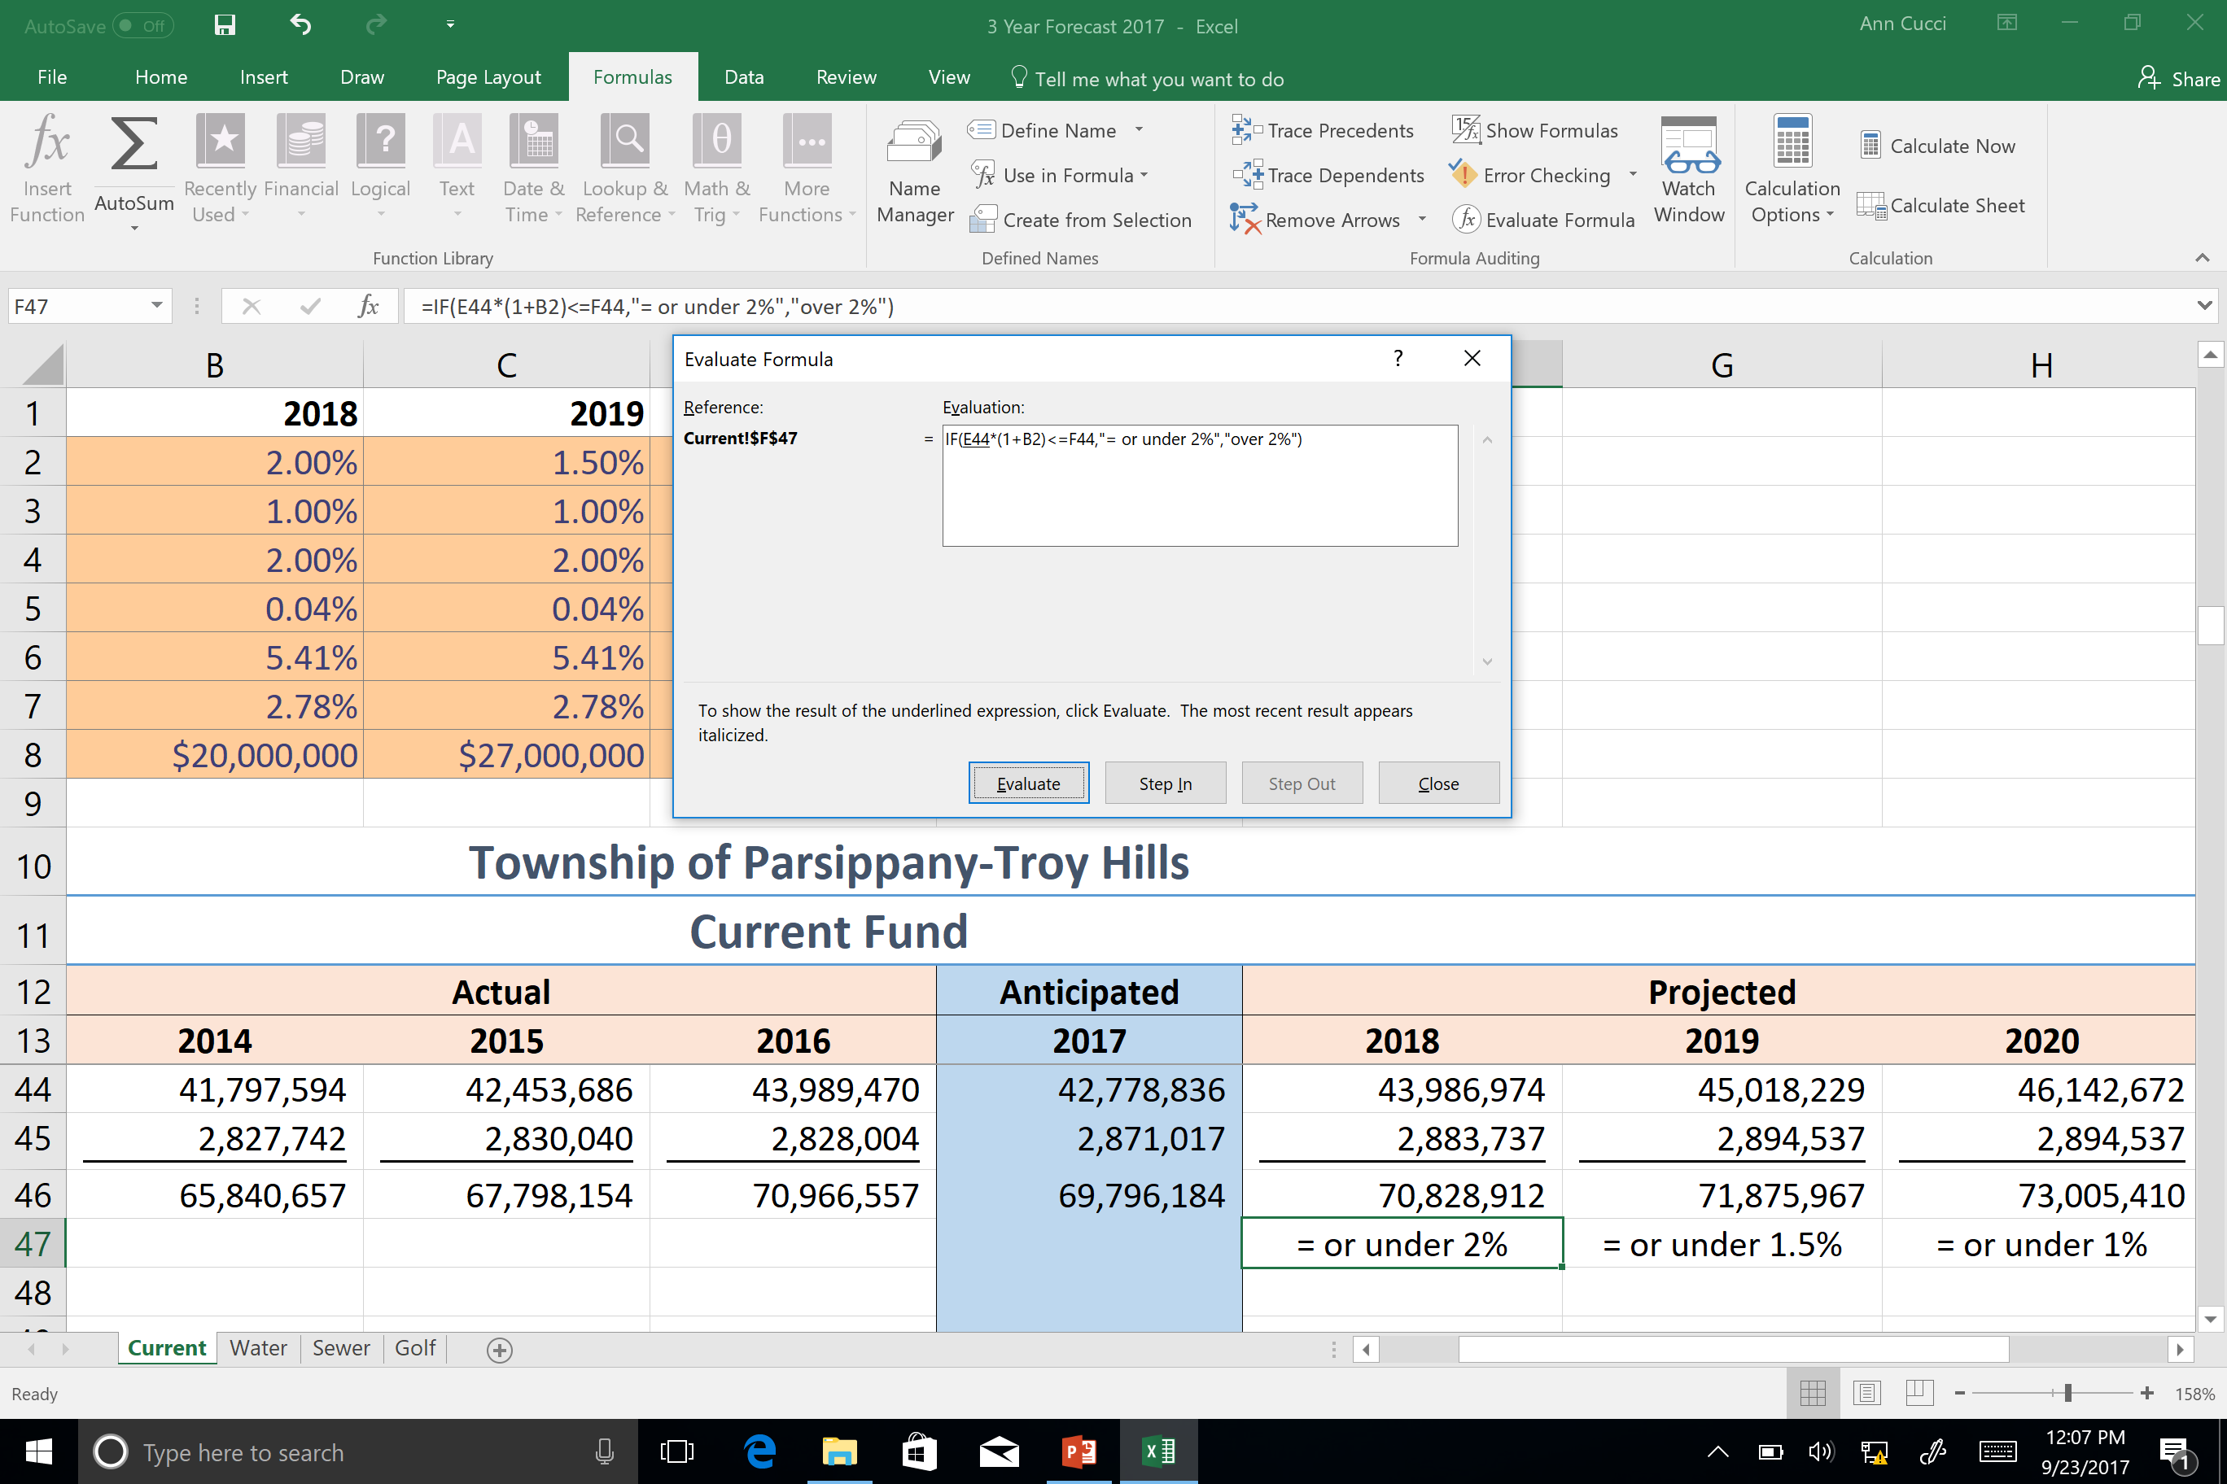
Evaluate Formula
Notes:
Sometimes, understanding how a nested formula calculates the final result is difficult because there are several intermediate calculations and logical tests. However, by using the Evaluate Formula dialog box, you can see the different parts of a nested formula evaluated in the order the formula is calculated. For example, the formula =IF(AVERAGE(D2:D5)>50,SUM(E2:E5),0)is easier to understand when you can see the following intermediate results:

Slide 56

Notes:
You can “step In” for more detail or “step Out”

Slide 57
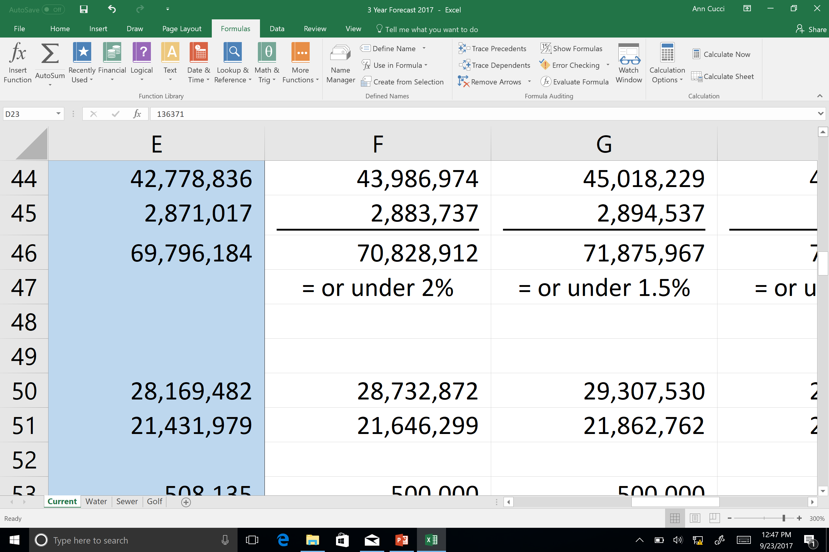
No Formulas
Notes:
We can show formulas

Slide 58
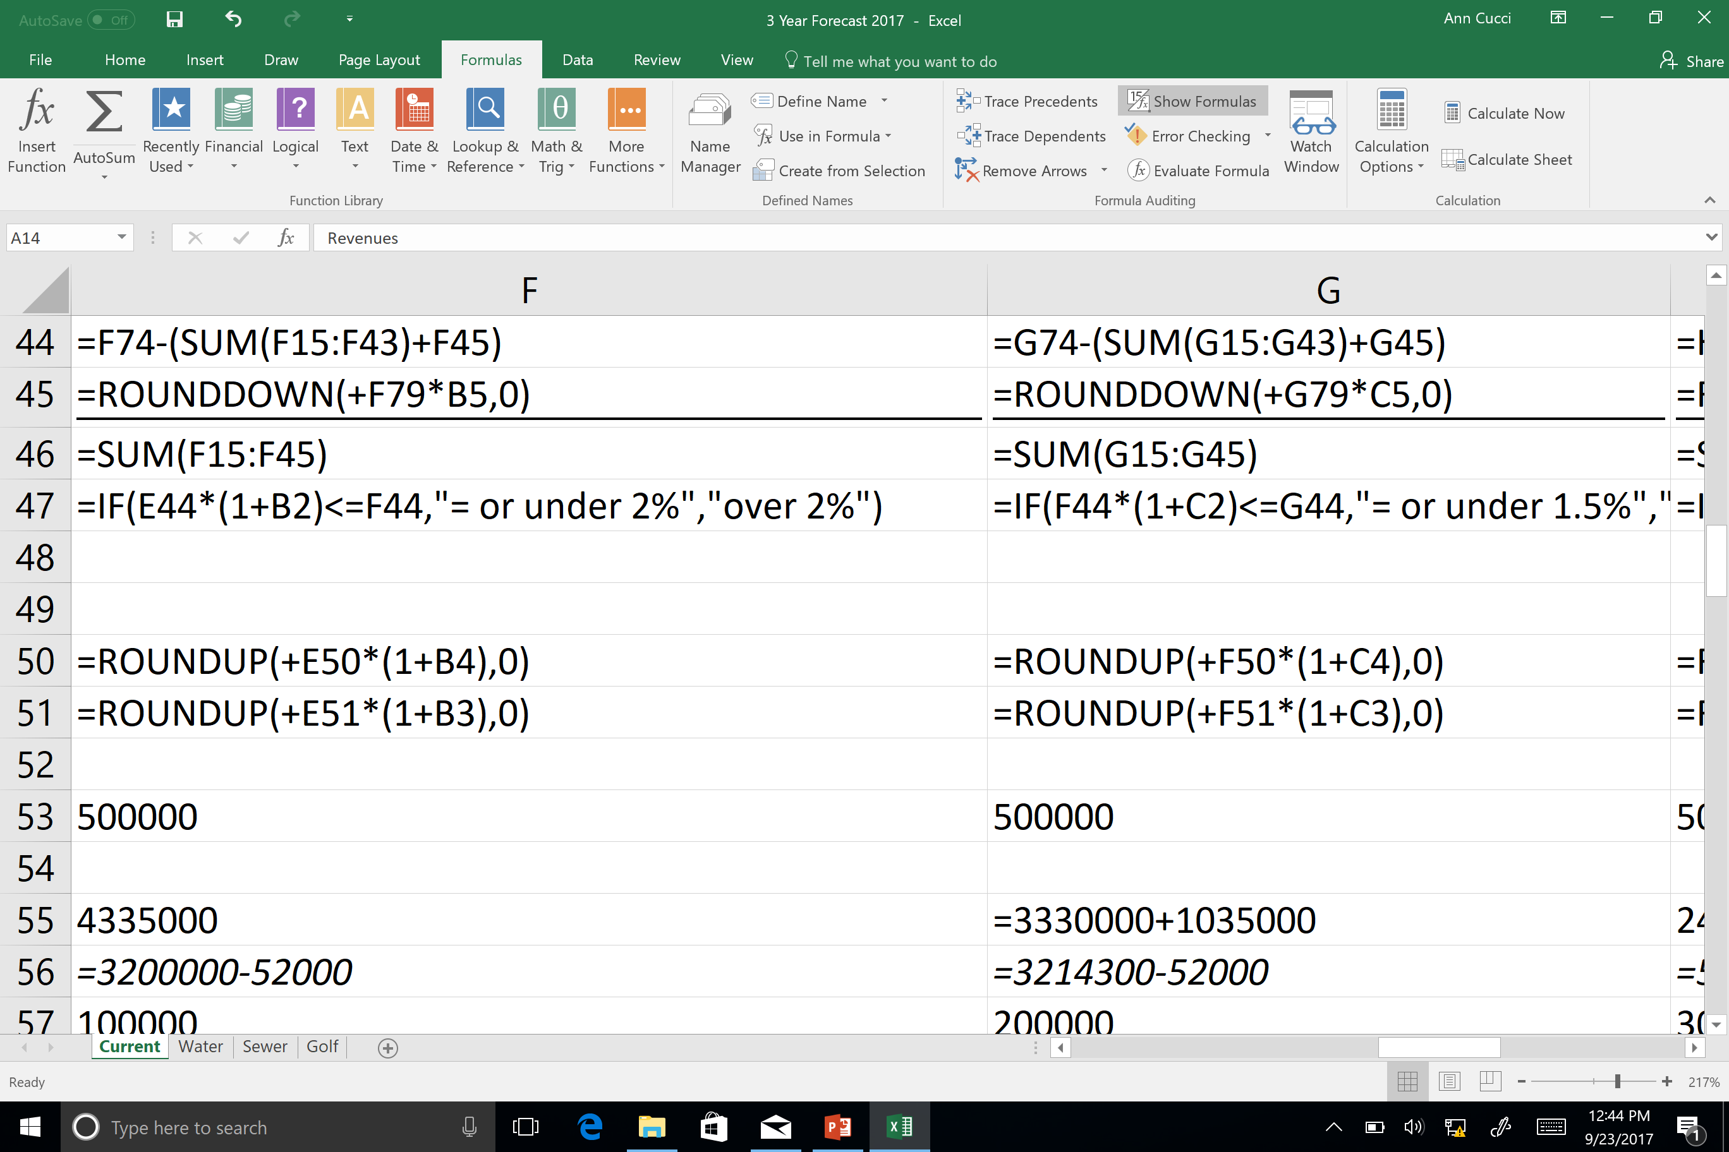
Show Formulas
Notes:
n the Evaluate Formula dialog box
Description
=IF(AVERAGE(D2:D5)>50,SUM(E2:E5),0)
The nested formula is initially displayed. The AVERAGE function and the SUM function are nested within the IF function.
The cell range D2:D5 contains the values 55, 35, 45, and 25, and so the result of the AVERAGE(D2:D5) function is 40.
=IF(40>50,SUM(E2:E5),0)
The cell range D2:D5 contains the values 55, 35, 45, and 25, and so the result of the AVERAGE(D2:D5) function is 40.
=IF(False,SUM(E2:E5),0)
Because 40 is not greater than 50, the expression in the first argument of the IF function (the logical_test argument) is False.
The IF function returns the value of the third argument (the value_if_false argument). The SUM function is not evaluated because it is the second argument to the IF function (value_if_true argument), and it is returned only when the expression is True.
Select the cell that you want to evaluate. Only one cell can be evaluated at a time.
Select the Formulas tab > Formula Auditing > Evaluate Formula.
Click Evaluate to examine the value of the underlined reference. The result of the evaluation is shown in italics.
If the underlined part of the formula is a reference to another formula, click Step In to display the other formula in the Evaluation box. Click Step Out to go back to the previous cell and formula.
The Step In button is not available for a reference the second time the reference appears in the formula, or if the formula refers to a cell in a separate workbook.
Continue clicking Evaluate until each part of the formula has been evaluated.
To see the evaluation again, click Restart.
To end the evaluation, click Close.

Slide 59

Formatting
Notes:
PRINTING
Inserting Moving

Slide 60
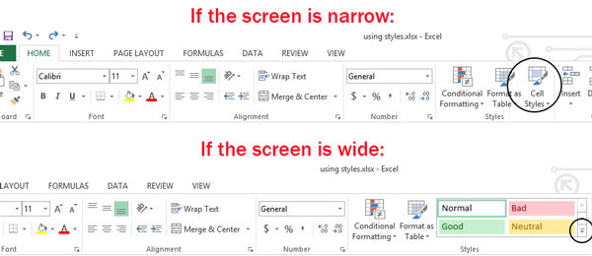
Built in Styles
Notes:
There are two advantages to using styles:
Speed. When you have a lot of cells to format, it’s faster to apply a style than to apply all the formatting features individually. And if you need to change a formatting feature of all the cells – like just the color or the font – changing the style definition will immediately update the cell formatting.
Consistency. When formatting a lot of cells, it’s easy to make a mistake and select a slightly different color or font size. But when you apply styles, the exact, same formatting gets applied every time.
Excel has built-in styles that you can use, and you can also modify them and create your own. Here's how.

Slide 61
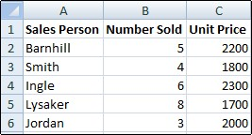
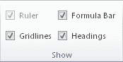
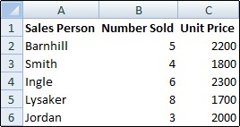
Do I want Gridlines???
On the View tab, in the Show group, clear the Gridlines check box.
Notes:
On the View tab, in the Show group, clear the Gridlines check box.

Slide 62
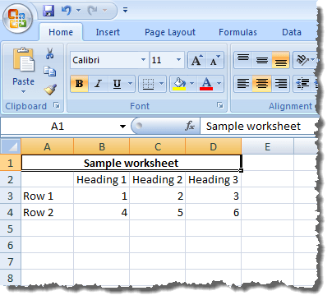
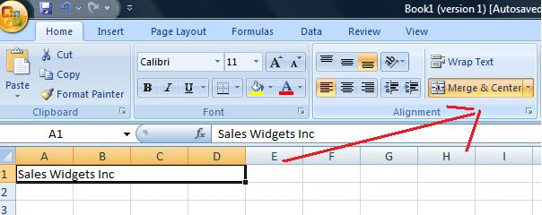
Merge & Center

Slide 63

Pet PEVES (for me)
Not Saving Your Spreadsheet at A1 (or at the beginning)
Centering Numbers
Different Fonts
No Labels
Not doing the formula in Excel
Inconsistent Number formats
Putting a number into a spreadsheet then making the font “white” so it’s hidden.
Manual indenting vs using the indent function
Notes:
Formula vs Calculate it then put number in

Slide 64
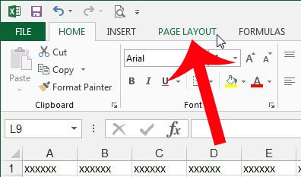
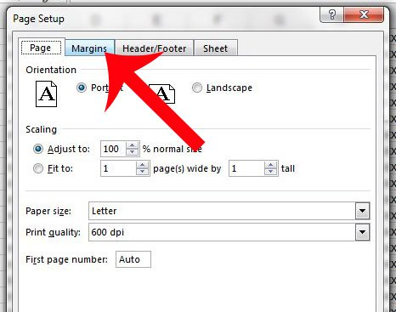
File Names & Printing…
Notes:
Make a file name that makes sense.

Slide 65
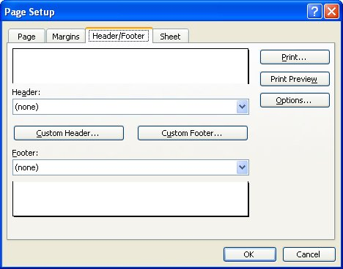
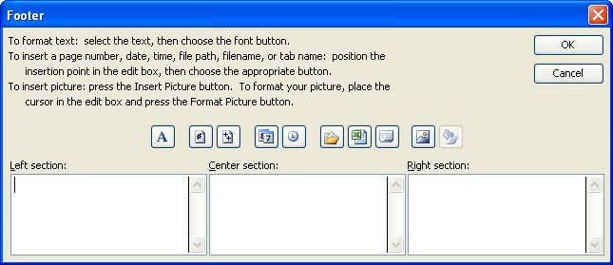
Footer:
From Page Setup
I add the Date
&[Date] = 9/27/2017
File name & path
&[Path]&[File] =
E:\Par Troy\Budget\Knoll Revenue

Slide 66
Ways to Screw up your spreadsheet
The sheet has a million rows and I’m going to fill them all!!!!!!!!!!
There are 1,048,576 rows and 16,384 columns
I know a few blank cells won’t matter
I put as much as possible in each cell!
Good example is names – first & last…break data into the smallest reasonable pieces.
I did it myself!
Can build from a template or someone else's spreadsheet
I love to jazz up my spreadsheets with WordArt
I put everything on Sheet1 so it’s easy to find
I put everything on a whole bunch of sheets
Notes:
T1: That sheet has a million rows and I'm going to fill them all!
I use Excel as my database
I know a few blank cells won't matter
I always start at A1
I put as much as possible in each cell
An Excel sheet isn't a trash compactor. The more data you put into a single cell, the fewer opportunities you'll have to use and extract the data you need. Instead, atomize! Within the context of designing a spreadsheet, atomize means to break down your data into the smallest possible elements. For instance, if you're storing names, split the first and last names into two columns instead of one. If you store the names in firstname lastname format, you can't sort by last name. If you think the easy solution to that dilemma is to use lastname firstname format, you might get a surprise later on — someone is sure to ask for that type by first names. Always break your data into the smallest reasonable pieces. You can concatenate values later, but it's difficult to reverse-engineer data.
7: I did it myself!
This is one of those tips that won't benefit the folks who need it the most — they won't recognize themselves. Most of us (and I include myself in this group) don't have all the necessary skills to build from scratch every spreadsheet we need. We're not stupid. We just lack a particular skill set. When you don't feel quite up to the task, rely on someone else. It's okay to start with a prebuilt template and make changes to meet your needs. Your end product will be more dependable and you'll save time.
6: I set all my sheets to manual to speed things up
By default, Excel automatically recalculates formulas when a dependent cell changes. In a poorly designed or large workbook, all that calculating can slow things down. A common reaction to a slow workbook is to set the calculation mode to manual. The sheet will then recalculate only when you explicitly tell it to by pressing [F9]. There's an unseen consequence to this madness, though: Eventually, you will refer to a value that hasn't been updated. Manual calculation isn't bad; it just isn't the right fix for a slow workbook.
9

Slide 67
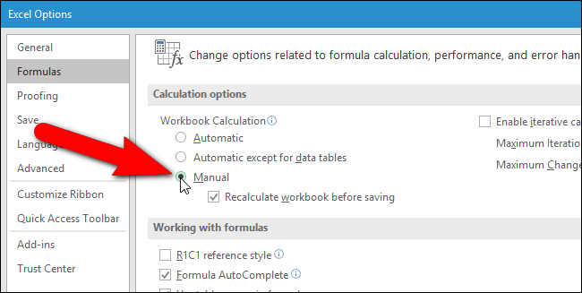
Ways to Screw up your spreadsheet
I set all my sheets to manual to speed things up!

Slide 68
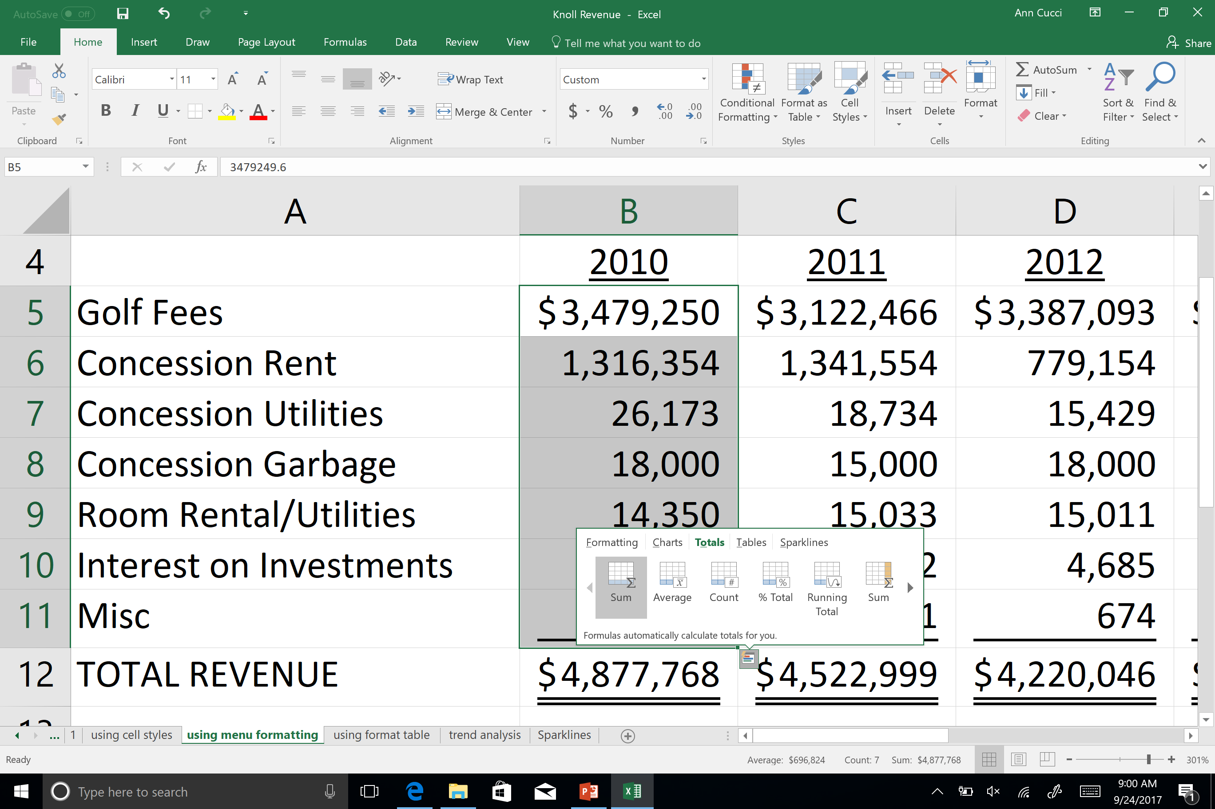
Quick Analysis:
Notes:
he Quick Analysis tool (available in Excel 2016 and Excel 2013 only) let you total your numbers quickly. Whether it’s a sum, average, or count you want, Excel shows the calculation results right below or next to your numbers.
Select the cells that contain numbers you want to add or count.
Click the Quick Analysis button in the bottom-right corner of the selection.
Click Totals, move your cursor across the buttons to see the calculation results for your data, and then click the button to apply the totals.
Click the Quick Analysis button in the bottom-right corner of the selection.

Slide 69


Slide 70

Merge & Center

Slide 71

Using the Format Menu on the Ribbon

Slide 72

Use Cell Styles

Slide 73


Slide 74

Use Format as Table

Slide 75


Slide 76

Trend Analysis ~ Conditional Formatting

Slide 77


Slide 78


Slide 79


Slide 80


Analyzing Trends Using Sparklines
Notes:
Select a blank cell near the data you want to show in a sparkline.
On the Insert tab, in the Sparklines group, click Line, Column, or Win/Loss.
Sparklines are tiny charts inside single worksheet cells that can be used to visually represent and show a trend in your data. Sparklines can draw attention to important items such as seasonal changes or economic cycles and highlight the maximum and minimum values in a different color. Showing trends in your worksheet data can be useful, especially when you’re sharing your data with other people.
Worksheet with sparklines

Slide 81

Using Sparklines

Slide 82

Create Sparkline Menu

Slide 83


Slide 84


Slide 85


Slide 86

Protect your work!
Notes:
Restrict your work to Few Columns And Rows (boss proof)

Slide 87

Mark as Final
Notes:
arking a workbook as final will not prevent others from editing it. If you want to prevent people from editing it, you can use the Restrict Access option instead.

Slide 88


Enable Worksheet Protection
Step 1
Unlock any cells that need to be editable
Simply uncheck “Locked”

Slide 89


Enable Worksheet Protection
Step 2
In Review tab, click Protect Sheet.
Allow users to do specific functions.
Put a Password to unprotect sheet.(Optional)
Notes:
Which level of protection should I use?
To control the level of access users should have to an Excel file, use file-level protection. Let’s say you have a weekly status report of your team members in an Excel file. You don’t want anyone outside your team to be even able to open the file. There are two options available:
If you don’t want others to open your file: You can encrypt the Excel file, which is the most common technique used. This basically means you lock it with a password and nobody except you can open it.
If you want to enable Read-only or editing access to different users: Maybe, you want the managers in your team to be able to edit the weekly status report, but team members should only have Read-only access. You can protect the Excel file by specifying two passwords: one to open, and the other to modify. You can later share the appropriate passwords with the team depending on the access they should be given.
To control how users should work with worksheets inside a your workbook’s structure, use workbook-level protection. Let’s say your status report workbook has multiple worksheets, and each worksheet is named after a team member. You want to make sure each team member can add data to their own worksheet, but not be able to modify any of the worksheets in the workbook, whether it be adding a new worksheet, or moving worksheets around within the workbook.
To control how users should work within an individual worksheet, use worksheet-level protection. Let’s say each worksheet in your status report workbook contains data that is common to all worksheets, like header rows or a specific report layout, and you really don’t want anyone to change it. By protecting your worksheet, you can specify that users can only perform specific functions in a sheet. For example, you can give users the ability to enter data, but keep them from deleting rows or columns, or only insert hyperlinks or sort data.

Slide 90

Notes:
Longevity

Slide 91

Questions?

